Slide 1
Astro 331 Lesson 3
Space Mission Geometry
SMAD Ch 5.2-5.3

Slide 2
Lesson Objectives
Sketch and label key space mission geometry parameters on 2D and 3D representations of the Earth
Perform space mission geometry calculations to identify whether a set of given parameters will satisfy mission requirements
Perform space mission geometry calculations to identify the value(s) for an unknown parameter that will be compatible with other given space mission parameters

Slide 3
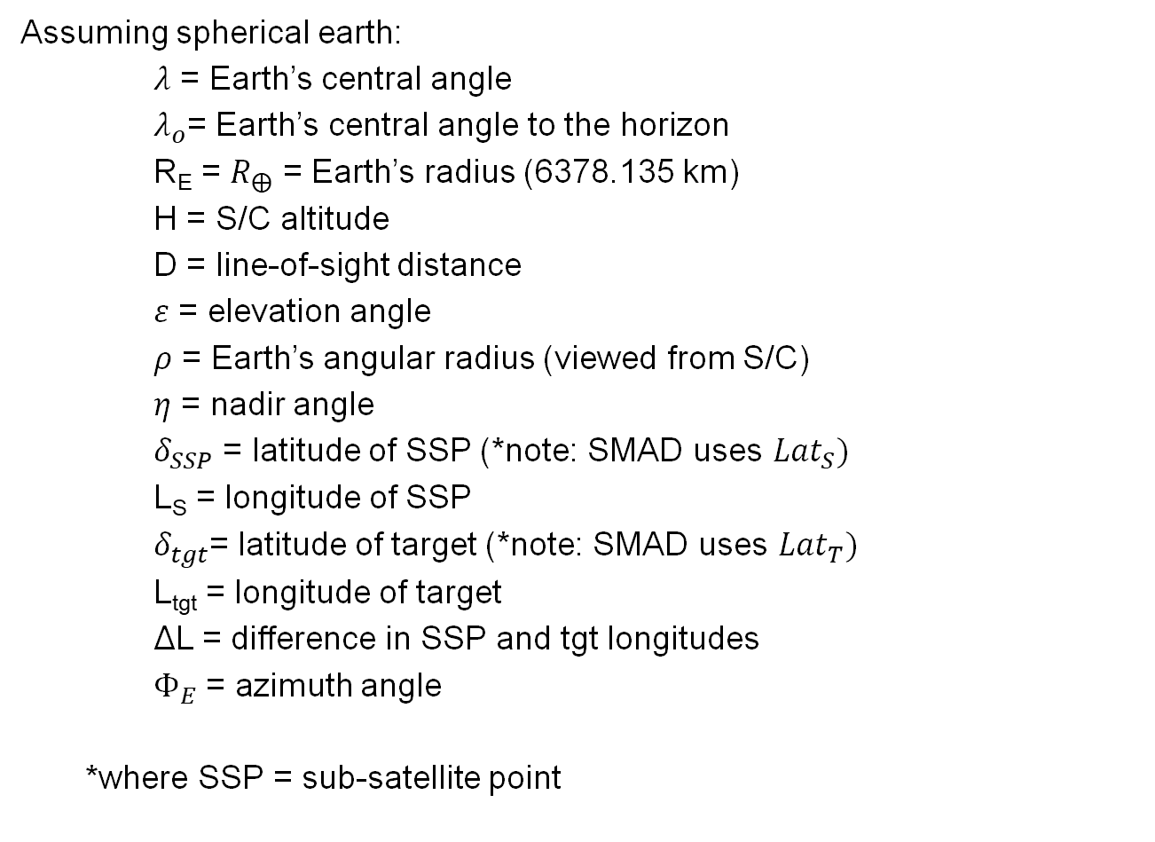
Terms Definitions
Assuming spherical earth:
$λ$ = Earth’s central angle
$λ_{o}$= Earth’s central angle to the horizon
R_{E} = $R_{⨁}$ = Earth’s radius (6378.135 km)
H = S/C altitude
D = line-of-sight distance
$ε$ = elevation angle
$ρ$ = Earth’s angular radius (viewed from S/C)
$η$ = nadir angle
$δ_{SSP}$ = latitude of SSP (*note: SMAD uses ${Lat}_{S})$
L_{S} = longitude of SSP
$δ_{tgt}$= latitude of target (*note: SMAD uses ${Lat}_{T})$
L_{tgt} = longitude of target
ΔL = difference in SSP and tgt longitudes
$Φ_{E}$ = azimuth angle
*where SSP = sub-satellite point

Slide 4
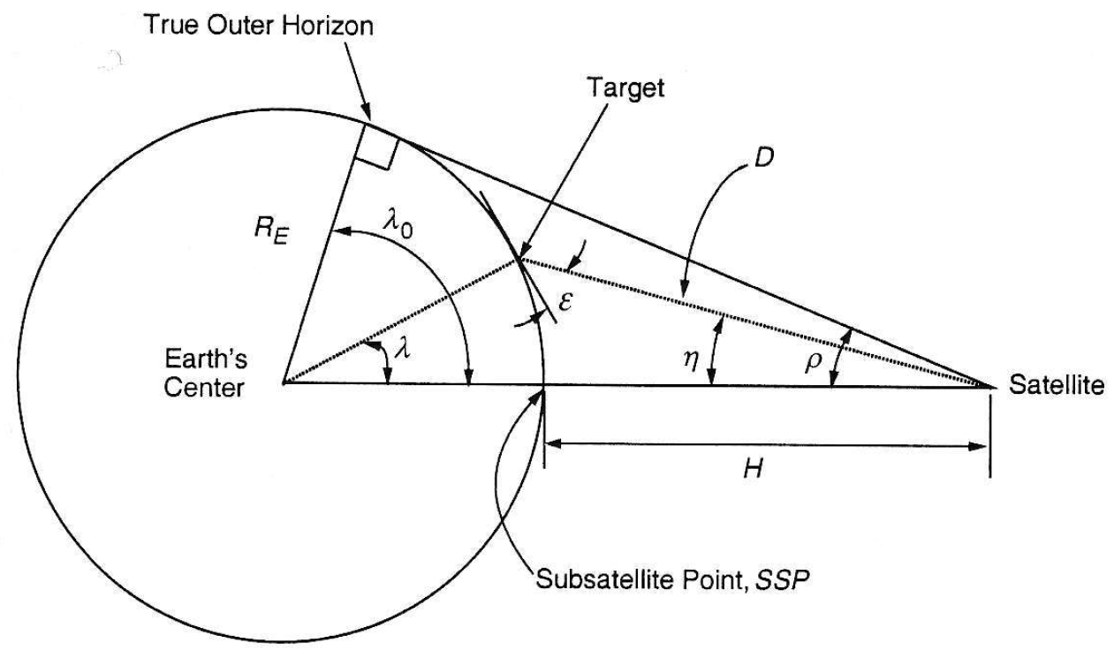
Earth Geometry Viewed from Space (2D)
Fig 5-13 Definition of Angular Relationships Between Satellite, Target, and Earth Center

Slide 5
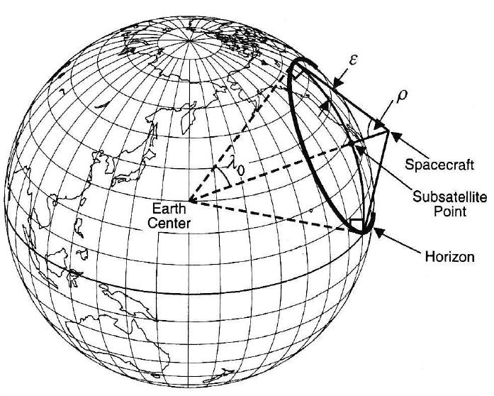
Earth Geometry Viewed from Space (3D)
Fig 5-11 Relationship Between Geometry as Viewed from the Spacecraft and from the Center of the Earth

Slide 6
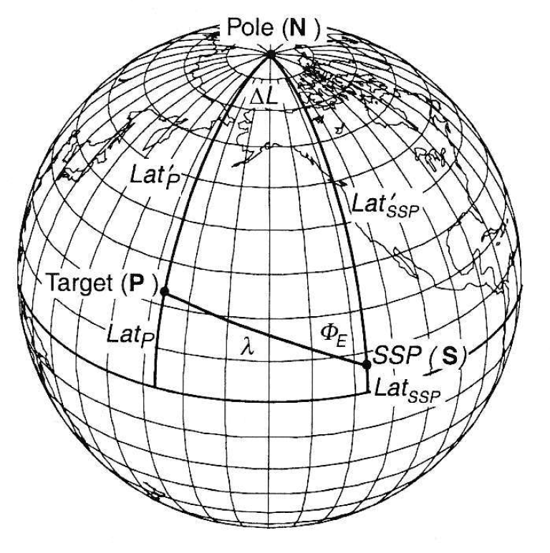

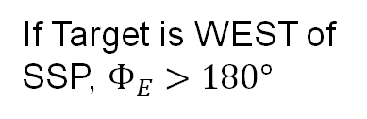
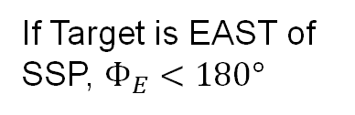
Earth Geometry Viewed from Space (3D)
If Target is EAST of SSP, $Φ_{E}<180°$
If Target is WEST of SSP, $Φ_{E}>180°$
$$Φ_{E}$$
Fig 5-12 Relationship Between Target and Subsatellite Point on the Earth’s Surface

Slide 7

Note
Can express target location 3 different ways
1) $δ$_{tgt}, L_{tgt} (latitude and longitude)
2) $λ$, $Φ_{E}$ (from SSP on Earth-centered sphere)
3) $η$, $Φ_{E}$ (from SSP on S/C-centered sphere)

Slide 8
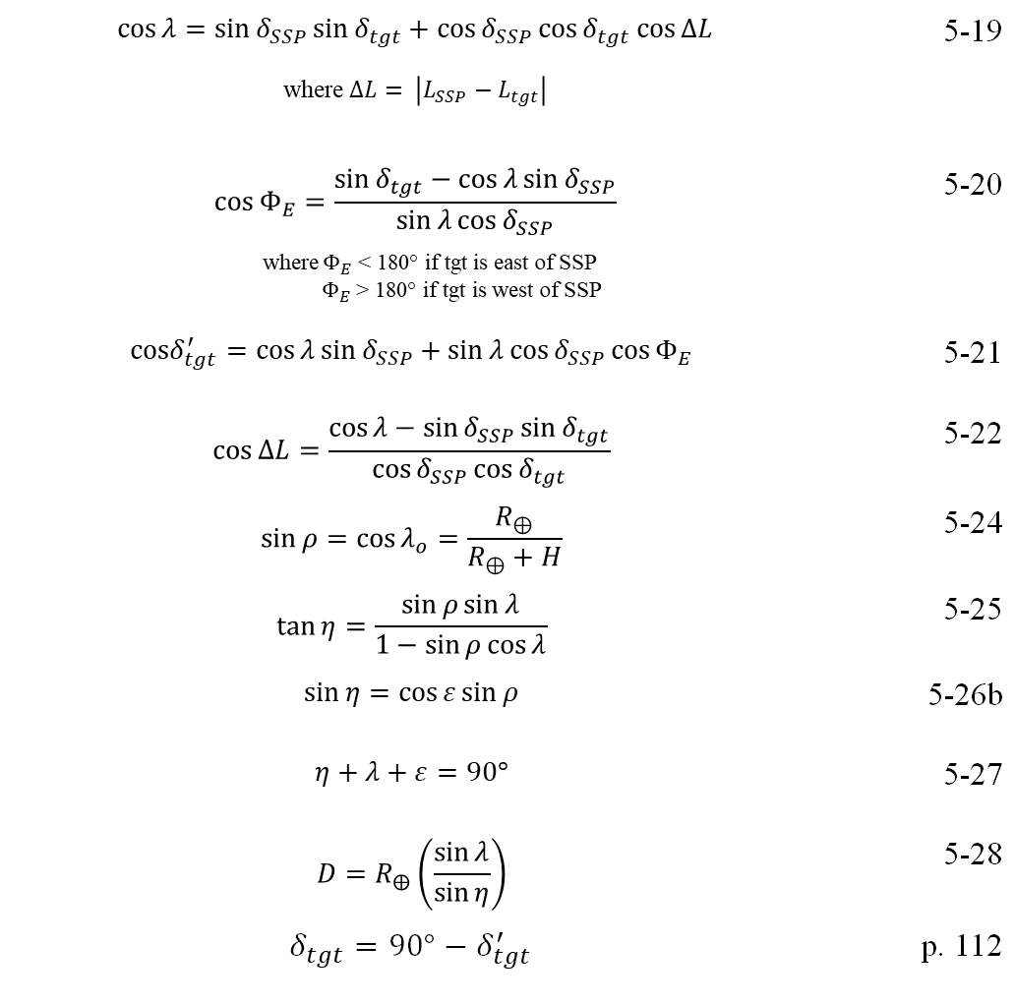
Equations (pt 1)
$$\cos{λ=\sin{δ_{SSP}}\sin{δ_{tgt}}+\cos{δ_{SSP}}\cos{δ_{tgt}}\cos{ΔL}}$$ where $∆L= \left|L_{SSP}−L_{tgt}\right|$ | 5-19
$$\cos{Φ_{E}}=\frac{\sin{δ_{tgt}−\cos{λ}\sin{δ_{SSP}}}}{\sin{λ}\cos{δ_{SSP}}}$$ where $Φ_{E}$ < 180° if tgt is east of SSP $Φ_{E}$ > 180° if tgt is west of SSP | 5-20
$$cosδ_{tgt}^{′}{=\cos{λ}\sin{δ_{SSP}}+\sin{λ}\cos{δ_{SSP}}\cos{Φ_{E}}}$$ | 5-21
$$\cos{ΔL}=\frac{\cos{λ−\sin{δ_{SSP}}\sin{δ_{tgt}}}}{\cos{δ_{SSP}}\cos{δ_{tgt}}}$$ | 5-22
$$\sin{ρ}=\cos{λ_{o}}=\frac{R_{⊕}}{R_{⊕}+H}$$ | 5-24
$$\tan{η}=\frac{\sin{ρ}\sin{λ}}{1−\sin{ρ}\cos{λ}}$$ | 5-25
$$\sin{η}=\cos{ε}\sin{ρ}$$ | 5-26b
$$η+λ+ε=90°$$ | 5-27
$$D=R_{⨁}\left(\frac{\sin{λ}}{\sin{η}}\right)$$ | 5-28
$$δ_{tgt}={90°−δ}_{tgt}^{′}$$ | p. 112

Slide 9
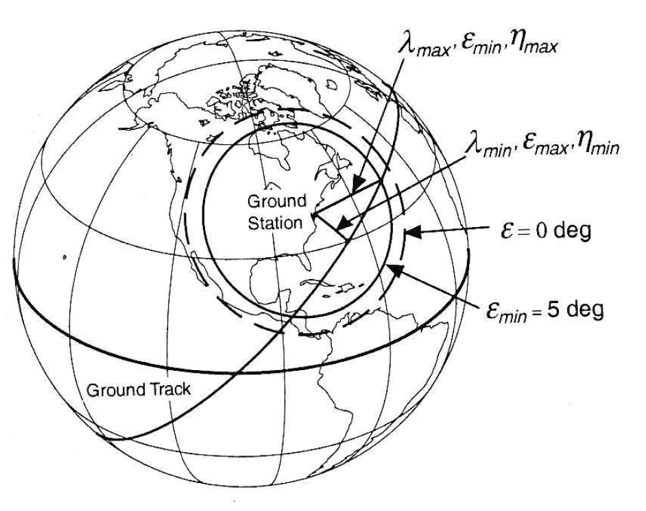
Geometry of Satellite Relative to an Earth Observer
Fig 5-17 Geometry of Satellite Ground Track Relative to an Observer on the Earth’s Surface

Slide 10
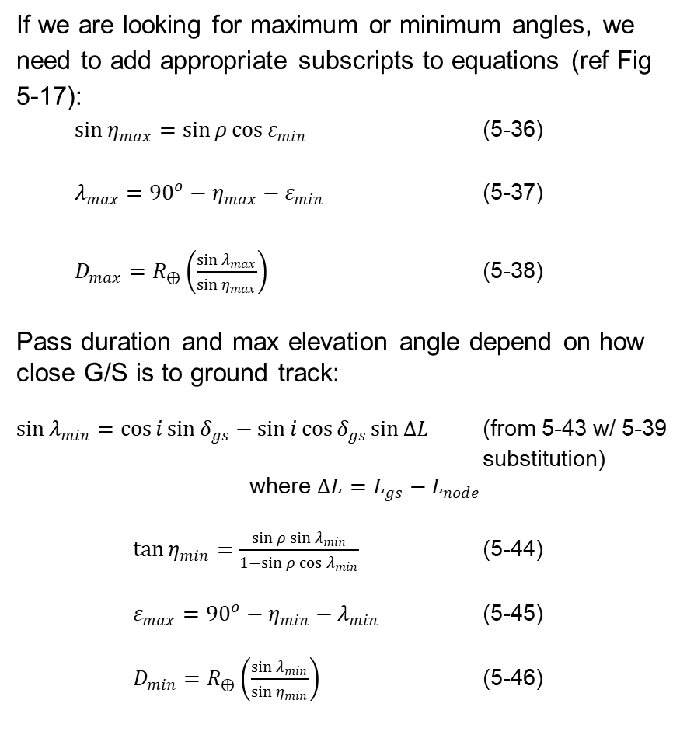
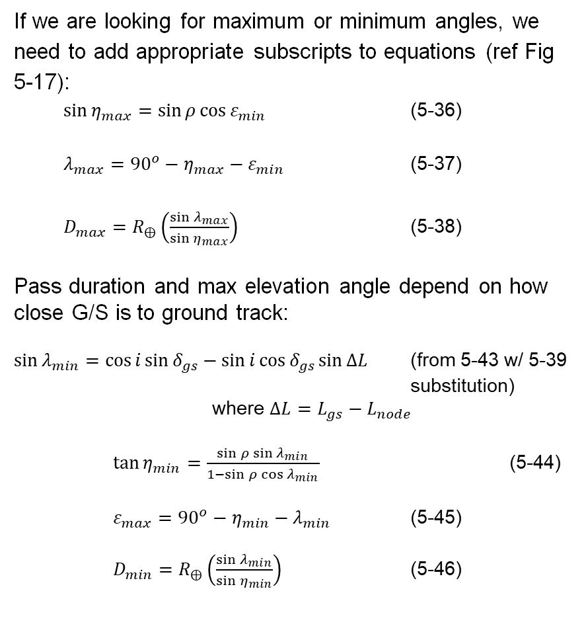
Equations (pt 2)
If we are looking for maximum or minimum angles, we need to add appropriate subscripts to equations (ref Fig 5-17):
$\sin{η_{max}}=\sin{ρ}\cos{ε_{min}}$ (5-36)
$λ_{max}={90}^{o}−η_{max}−ε_{min}$ (5-37)
$D_{max}=R_{⨁}\left(\frac{\sin{λ_{max}}}{\sin{η_{max}}}\right)$ (5-38)
Pass duration and max elevation angle depend on how close G/S is to ground track:
$\sin{λ_{min}}=\cos{i}\sin{δ_{gs}}−\sin{i}\cos{δ_{gs}}\sin{ΔL}$ (from 5-43 w/ 5-39 substitution)
where $ΔL=L_{gs}−L_{node}$
$\tan{η_{min}}=\frac{\sin{ρ}\sin{λ_{min}}}{1−\sin{ρ}\cos{λ_{min}}}$ (5-44)
$ε_{max}={90}^{o}−η_{min}−λ_{min}$ (5-45)
$D_{min}=R_{⨁}\left(\frac{\sin{λ_{min}}}{\sin{η_{min}}}\right)$ (5-46)
Fig 5-17 Geometry of Satellite Ground Track Relative to an Observer on the Earth’s Surface

Slide 11
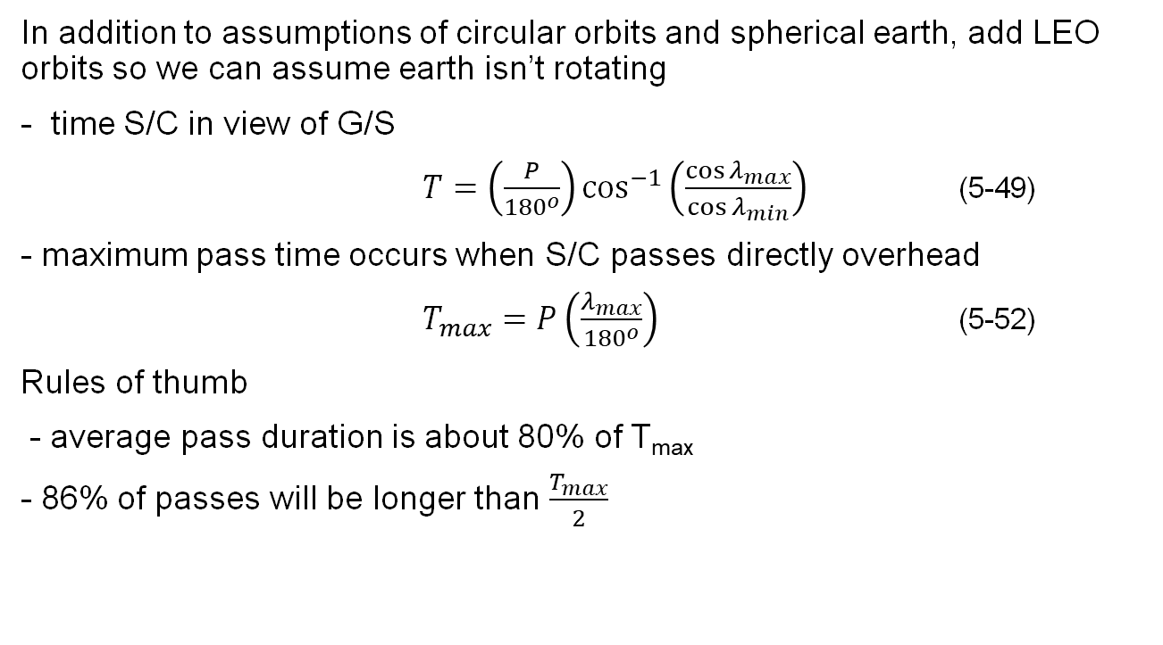
Equations (pt 3)
In addition to assumptions of circular orbits and spherical earth, add LEO orbits so we can assume earth isn’t rotating
- time S/C in view of G/S
$T=\left(\frac{P}{{180}^{o}}\right)\cos^{−1}\left(\frac{\cos{λ_{max}}}{\cos{λ_{min}}}\right)$ (5-49)
- maximum pass time occurs when S/C passes directly overhead
$T_{max}=P\left(\frac{λ_{max}}{{180}^{o}}\right)$ (5-52)
Rules of thumb
- average pass duration is about 80% of T_{max}
- 86% of passes will be longer than $\frac{T_{max}}{2}$

Slide 12
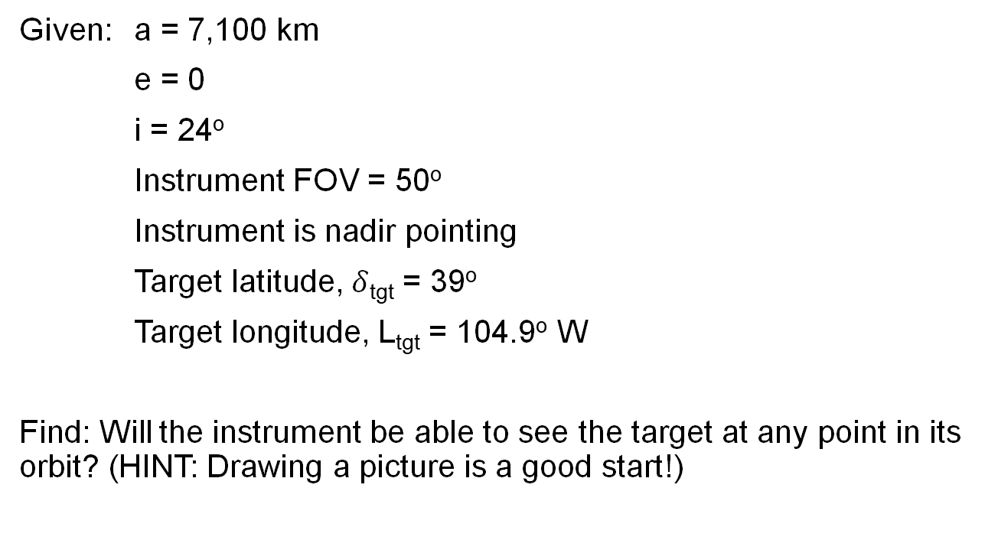
Example
Given: a = 7,100 km
e = 0
i = 24º
Instrument FOV = 50º
Instrument is nadir pointing
Target latitude, $δ$_{tgt} = 39º
Target longitude, L_{tgt} = 104.9º W
Find: Will the instrument be able to see the target at any point in its orbit? (HINT: Drawing a picture is a good start!)

Slide 13
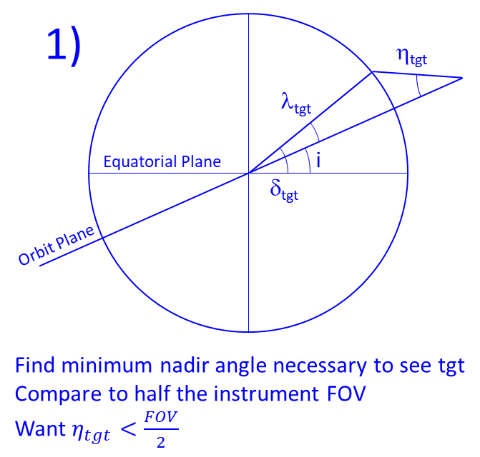
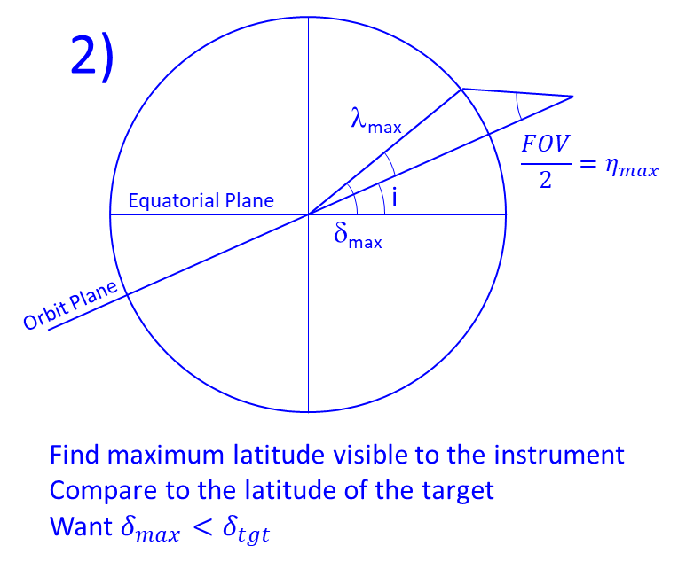
Solution (1/3)
There are (at least) two approaches:

Slide 14
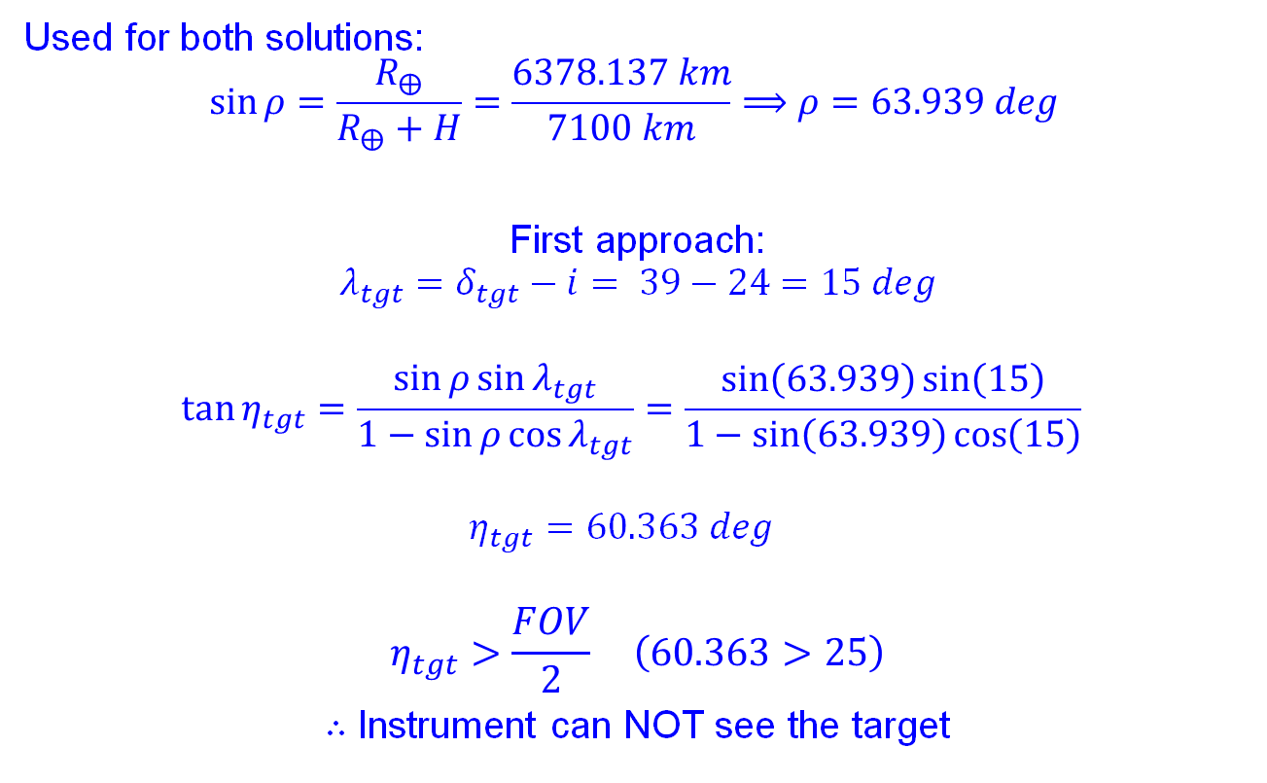
Solution (2/3)
Used for both solutions:
$$\sin{ρ}=\frac{R_{⨁}}{R_{⨁}+H}=\frac{6378.137 km}{7100 km}⟹ρ=63.939 deg$$
First approach:
$$λ_{tgt}=δ_{tgt}−i= 39−24=15 deg$$
$$\tan{η_{tgt}}=\frac{\sin{ρ}\sin{λ_{tgt}}}{1−\sin{ρ}\cos{λ_{tgt}}}=\frac{\sin\left(63.939\right)\sin\left(15\right)}{1−\sin\left(63.939\right)\cos\left(15\right)}$$
$$η_{tgt}=60.363 deg$$
$$η_{tgt}>\frac{FOV}{2} \left(60.363>25\right)$$
$∴$ Instrument can NOT see the target

Slide 15
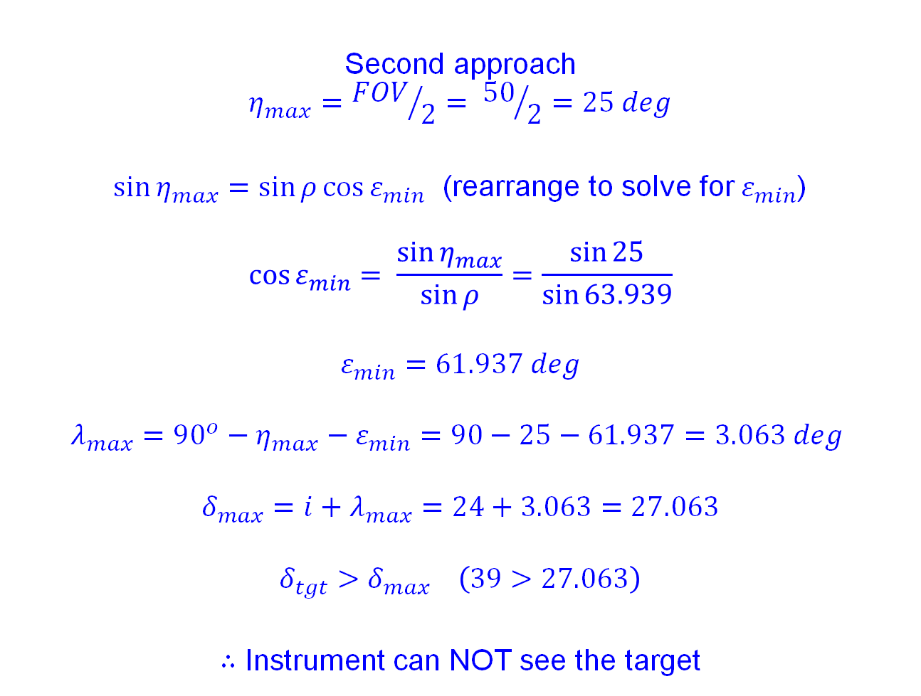
Solution (3/3)
Second approach
$$η_{max}={FOV}/2= {50}/2=25 deg$$
$\sin{η_{max}}=\sin{ρ}\cos{ε_{min}}$ (rearrange to solve for $ε_{min}$)
$${\cos{ε}}_{min}= \frac{\sin{η_{max}}}{\sin{ρ}}=\frac{\sin{25}}{\sin{63.939}}$$
$$ε_{min}=61.937 deg$$
$$λ_{max}={90}^{o}−η_{max}−ε_{min}=90−25−61.937=3.063 deg$$
$$δ_{max}=i+λ_{max}=24+3.063=27.063$$
$$δ_{tgt}>δ_{max} \left(39>27.063\right)$$
$∴$ Instrument can NOT see the target

